Slide 1
Inpatient Treatment & Research For Youth with Autism and ID
Matthew Siegel, M.D.
Professor of Psychiatry & Pediatrics
Tufts University School of Medicine
Vice President of Medical Affairs
Maine Behavioral Healthcare
Faculty Scientist III
MaineHealth Institute for Research

Slide 2
Agenda
Autism & Behavioral Challenges
Psychiatric Hospitalization
Maine Continuum of Care
Inpatient Research Collaborative
Specialized vs. General Child Units
Care Pathway for Psychiatric Units
Consensus Recommendations for Inpatient Care

Slide 3
Serious Challenging Behavior in Youth with Autism
Aggression:
1584 youth - ATN Parent Survey
Is child currently demonstrating physical aggression?
53% Yes
Clinical sample - Mazurek et al.,2013
Self Injury:
8065 children from the Autism and
Developmental Disabilities
Monitoring Network (ADDM) Record review
28% Yes
Community sample - Soke et al., 2016

Slide 4
Aggression and Self Injury Impacts
Families report that aggression is often of greater concern and negative impact than the core social and communicative deficits that define ASD,
as it increases their stress, isolation, and financial burden, and decreases available support options
- Hodgetts S, et al. Focus Autism Other Dev Disabl. 2013; 28(3): 166-174
- Farmer CA, Aman MG. Res Autism Spectr Disord. 2011; 5(1): 317-323.
- Woodman AC, et al., Dev Psychopathol. 2016; 28(2): 565-581

Slide 5
Developmental Trajectory
Development
Age
Notes:
Here at 4 years old child with asd engages in self injury and is kicked out of preschool, spends 6 months at home with no services, eventually gets into a specialized pre-school.
Here at 7 years old the continuing self injury in a larger child is so distressing that family cannot be in public settings – no longer go to restaurants, library, grocery store and the world shrinks. Here at age 11 aggression starts, teacher injured, sent to er, hospitalized, kicked out of local public school, now sent to out of district special placement, lose peer interactions.

Slide 6
Etiology
Aggression / Self injury (Irritability)
Psychiatric Co-Morbidity
Behavioral Function, Reinforcement & Skill Deficits
Functional Communication Deficits
Family Changes
Dysregulated Sensory System
Demand:Ability Mismatch
Side Effects
Medical Illness/Pain Emotion Regulation Deficits Trauma
Genetically Linked Sleep Disorders Bullying/Social Challenges

Slide 7
Therapeutic Approaches For Challenging Behaviors
Applied behavior analysis
Medication treatment of psychiatric comorbidity
Communication strategies
(AAC/Functional Communication/Visual supports)
Social skills / social cognitive strategies
Psychotherapy approaches – CBT / Emotion regulation
Sensory regulation strategies
Treat Medical Problems
Family treatment / Parent Management Training (RUBI)

Slide 8
A National Issue:
Youth with Autism or ID in the Emergency Room
Massachusetts ER study:
  Diagnosis of Autism #1 predictor of ED boarding
  Diagnosis of Intellectual Disability #2
  - Wharff et al, 2011
13% of children with ASD present to the ER for mental health concerns, compared to 2% without ASD
- Kalb et al., 2012

Slide 9
Youth with ASD Have Very High Rates of Psychiatric Hospitalization
11% have been psychiatrically hospitalized by
age 21 - Mandell, Pediatrics, 2008
Study of 33,000 children with ASD. Youth with ASD psychiatrically hospitalized at a ratio of 6 : 1 compared to non-ASD children.
- Croen, Pediatrics, 2006
Notes:
Parent survey of 760 children
Study of 33,00 children enrolled in Kaiser Permanente group in nothern California
Most units reports 10-20% of admissions are asd/id

Slide 10
Chief Complaint for
Psychiatric Hospitalization In ASD/ID youth
- Siegel M, et al., JADD, 2011

Slide 11
Risk Factors for Hospitalization
Comparison of two age and gender matched ASD cohorts:
  Inpatients - Autism Inpatient Consortium (AIC)
  Outpatients - Rhode Island Consortium for Autism Research and Treatment (RI-CART)
Independently increased risk of psychiatric hospitalization:
  Lower adaptive functioning
  Greater ASD symptom severity
  Single primary caregiver
  Mood disorder
  Sleep problems - Righi G, et al, 2017, JADD

Slide 12
Barriers to Psychiatric Hospitalization for People with ASD
Limited number of specialized units and geographic maldistribution
Almost all units are for youth. Vanishingly few for adults (Pittsburgh, Michigan, Iowa, a few others)
Lack of knowledge, expertise and relevant treatment approaches in many general units.
Insurance rules in some states that require a primary psychiatric diagnosis for admission, and declare ASD not to be one.
Denial of care due to misunderstanding of autism symptoms
Institutional fear and stigma

Slide 13
Different Needs
Common Elements of Psychiatric Units | Youth with ASD/ID
Developed for internalizing/psychiatric problems | Have primarily externalizing, behavioral symptoms
Rely on verbal interventions: Talking with staff, discussing events, family meetings | May struggle to understand or become agitated with verbal interventions
Group programming with high social interaction demands | May not be able to participate in groups or meet social interaction demands
Frequent staff transitions, shifting schedules | Removed from preferred routines & caregivers, thrive on consistency
Unit point or level reinforcement systems Infrequent: daily to weekly reinforcement General reinforcers: unit store, hospital privileges | Are used to much higher frequency of reinforcement that is child-specific Agitated, excluded, non-reinforced, in room > aggression > seclusion/restraint

Slide 14

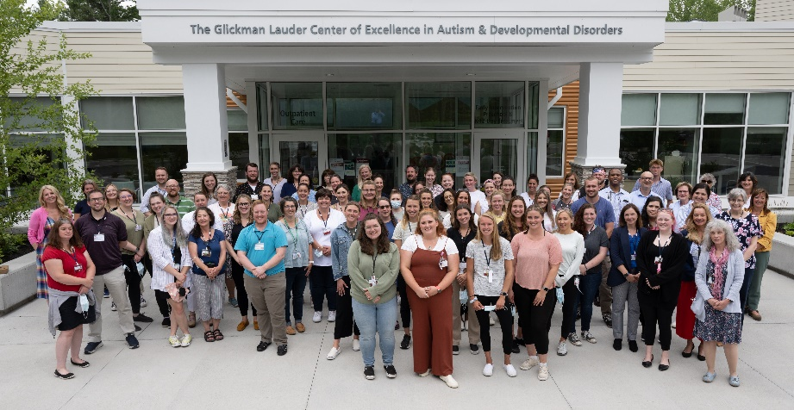
Developmental Disorders Service
Maine Behavioral Healthcare
Spring Harbor Hospital DD Unit,
Spring Harbor Academy, Partial Hospital Program,
K-12 and Preschool Day Treatment,
Toddler Early Intervention Program
Outpatient Clinic, Clinical Research Program
Notes:
An academically affiliated, community-oriented health system.

Slide 15
Developmental Disorders Service
An integrated continuum of care, research and training serving the lifespan
Spring Harbor
DD Unit & Academy
200+ FTE
$30M Annual Budget
DD Partial Hospital Program
Hospital
K-12 Day Treatment
Preschool Day Treatment
Toddler Treatment (Spec. Sect. 28)
Community Engagement & Training Family Navigator
Training in Social Work, Behavior Analysis (Psychology - future)
Clinical Research in Physiology, Behavior, Sleep, & Emotion Regulation
DD Behavioral IOP (future)
Outpatient – Glickman Lauder Center
DD Outpatient Clinic
Medical and Dental Support Services

Slide 16
Strengths of Our
System of Care
Multi-disciplinary team at every level
Behavioral psychologist or BCBA on every team
Patients move up and down the levels, direct hospital admissions, culture of responsibility
One medical record
80% of patients medicaid funded
Cross-service case conference, Registered Behavior Technician and Safetycare training for staff, and uniform formatting of behavior plans
Professional training supported for BCBAs, Social Workers, Special Educators, Medical students/residents/fellows, Occupational Therapists.
Clinical research embedded in most programs

Slide 17
Spring Harbor Hospital Developmental Disorders Unit (DDU)
Provide definitive, expert care to stabilize youth,
keep them in-state and in their homes.
12 bed self-contained unit
Average length of stay (pre-pandemic) 30-40 days
4-21 years old, co-ed
2/3 autism; 1/3 other (ID)
90% of youth referred are seeking residential treatment
Only 1/3 discharged to residential treatment
One of only ~18 units in the country (~9 in 2010)

Slide 18
Spring Harbor Inpatient Treatment Philosophy
Children, family and community systems can be engaged during inpatient stabilization to address the key sources of crisis.
Opportunity for intensive assessment and treatment of challenging behavior, teaching new skills and setting children up for success.
Rigorous diagnosis and treatment of psychiatric comorbidity improves outcomes and reduces polypharmacy.

Slide 19

Multi-Disciplinary
Treatment Team
Child Psychiatry
Nursing
Social Work
Behavioral Psychologist
Behavior Analyst (BCBA)
Special Education
Speech Language Pathologist
Occupational Therapist
Milieu Coordinator

Slide 20
Foundation of Treatment
Individualized positive behavior support plan
Targeted psychopharmacology
Transfer of management skills to parents,
local school, in-home staff

Slide 21
6 Year Old Girl with Autism Spectrum Disorder, Intellectual Disability (mild)
  Behaviors: Frequent tantrums (30-120 minutes/day total)
  accompanied by aggression (20-40 times/day).
  Communication: Non-verbal (<10 single words), reported to use PECS at school.
  Educational: Pre-K level abilities, with some splinter skills
  Physiologic: Awakening 3-4 times a night
  Medication: Risperidone 4 mg/day, Benadryl PRN
Notes:
21

Slide 22
Tantrum Etiology
(By History & Early Observation)
    Tired & Sedated
    Communication frustration
    Confused / disoriented:
    Lack of supports for environmental predictability
    Inconsistent expectations (even with our staff)
    FBA: Reinforcement of behavior by attending to screaming (attention function), allowing task avoidance (escape function)

Slide 23
a broad and deep intervention:
Tantrums +/- Aggression
Communication
Behavioral Response
Sleep Deficit
Structure Environment
Visual Schedule
Table Top Learning
Transfer to School/Parents
Behavior Plan
– Reinforce Non Tantrums
- Deny Escape
PECS trials in class (slp)
PECS use 24/7
Train parents/in-home
Sleep hygiene training with parents
Parents shadow and run plan
Sleep Hygiene
Trazodone
Visual Transition Countdown
Motor Breaks
Weaned off Risperidone

Slide 25
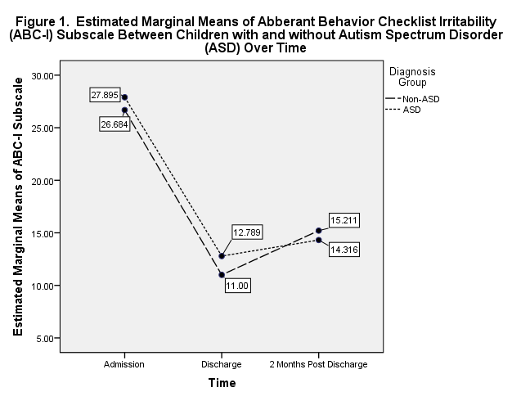
Change in Behavioral Functioning From Admission to Discharge to 2 month follow up
Siegel M, et al., JADD, July, 2014

Slide 26


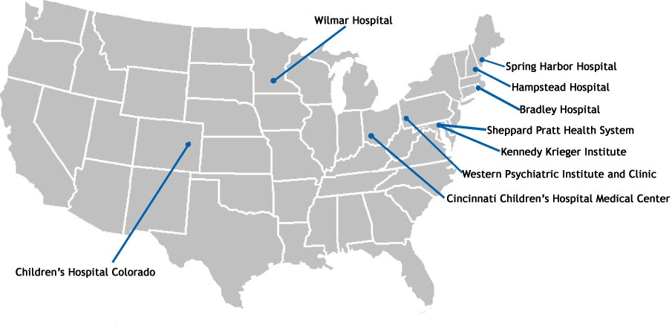
6 site inpatient research network
Continuously funded since 2013
Autism Inpatient Collection
  1500+ deeply phenotyped youth
  with high-confidence ASD and
  emotional/behavioral challenges
  Those with profound autism heavily represented (50% minimally verbal,42% ID)
  Phenotypic data, biological samples and exome
  sequencing available through SFARIBase to
  approved investigators
Emotion Dysregulation Inventory
Physiology associated with aggression
Cincinatti Children’s

Slide 27
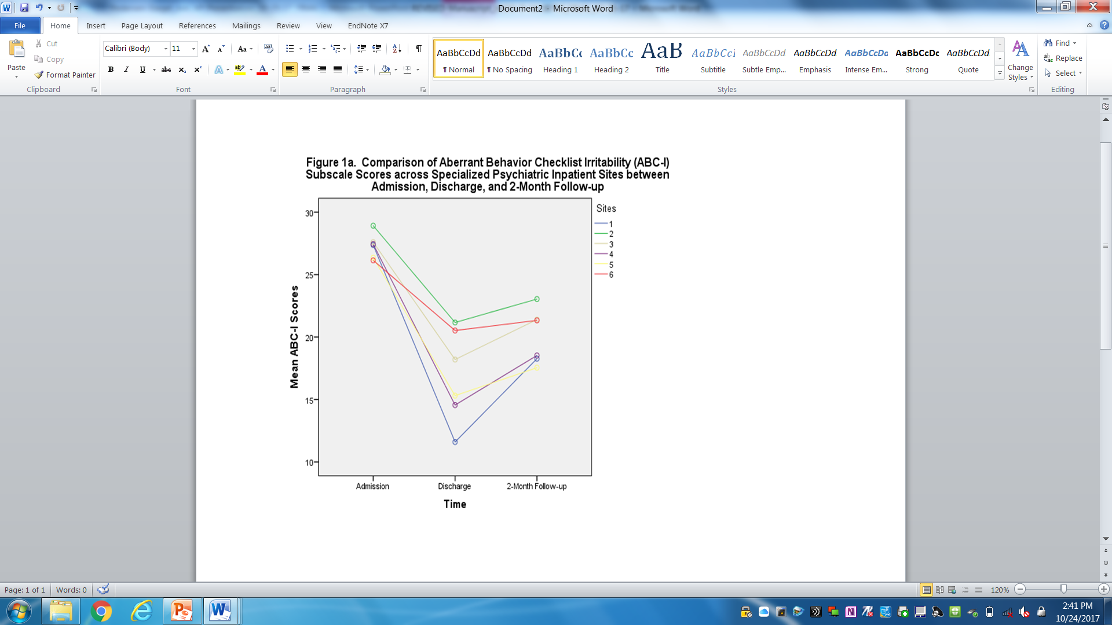
AIC: Change in Problem Behaviors
ABC-I Scores, n=350
Significant reduction in problem behavior scores from admission to discharge, and 2-month follow-up (p<0.05)
Admission: 29.7(9.6)
Discharge: 15.0(10.3)
2-Month Follow Up: 19.3(10.3)
Pedersen, KA, Santangelo, SL, Gabriels, RL…and Siegel M, Behavioral Outcomes of Specialized Psychiatric Hospitalization in the Autism Inpatient Collection (AIC). Journal of Autism and Developmental Disorders, 2017
Notes:
Mean iq=73, adaptive = 55, 52% ADOS MODULE 1OR2

Slide 28
Specialized vs. General Units
Children with ASD ages 4-20 were enrolled upon admission to either a specialized (N=53) or a general child psychiatric unit (N=27).
Caregivers completed the Aberrant Behavioral Checklist-Irritability Subscale (ABC-I) at admission, discharge, and two months post-discharge and reported information on crisis service utilization two months post-discharge.

Slide 29
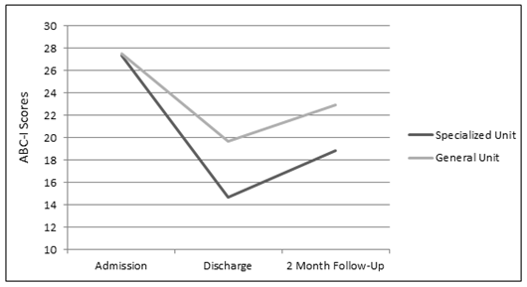
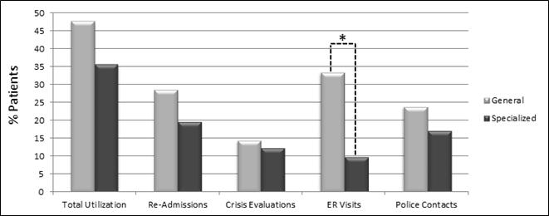
Results
Figure 1. Aberrant Behavioral Checklist–Irritability subscale scores at admission, discharge, and two months post-discharge between specialized and general psychiatry units
Figure 2. Percentage of participants requiring any psychiatric re-admissions, crisis evaluations, emergency room visits, or police contacts within two months post-discharge by specialized and general units
Children treated in the specialized unit had lower ABC-I scores at discharge and two months post-discharge (F=8.98, p=0.003) and were significantly less likely to experience an ER visit within two months post-discharge (X²=5.51, p=0.019).

Slide 30
Different Populations
Taylor BT, Sanders K, Kyle M, Pedersen KA, Veenstra-VanderWeele J and Siegel M, Inpatient Psychiatric Treatment of Serious Behavioral Problems in Children with Autism Spectrum Disorder (ASD): Specialized versus General Inpatient Units, J Autism Dev Disord. 2018.

Slide 31
How do we Improve Care - Scalability
Care Pathway for Youth with Autism Admitted to General Child Psychiatric Units
Implemented in a low resource, public psychiatric hospital. Bellevue Hospital in Lower Manhattan.
Development of pathway, staff training, pre-post data collection.
Compared 18 months pre-implementation (n=17) vs 18 months post implementation (n=20).
Kuriakose S, Filton B, Marr M…Siegel M, Horowitz, S, and Havens J, Does an Autism Spectrum Disorder care pathway improve care for children and adolescents with ASD in inpatient psychiatric units? J Autism Dev Disord. 2018 July 3

Slide 32
ASD-ID Care Pathway Elements
Key information at admission
Address the basics
Support predictability and activity
Positive behavior reinforcement plan
Concrete coping strategies
Enhance communication
Slides & Pathway developed with Sarah Kuriakose, Ph.D., NYU and Mollie Marr, BFA, Bellevue Hospital

Slide 33
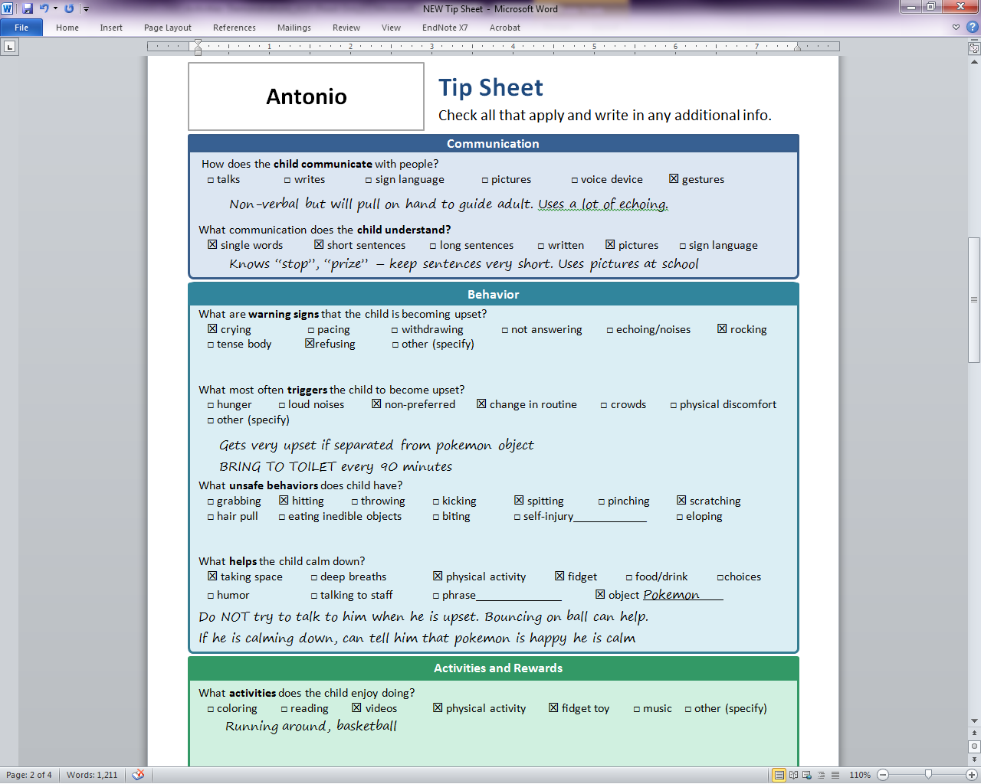
1. Collect Key Information Admission
Tip Sheet contains
key information
  Communication style
  Early warning signs
  of agitation
  Preferred activities
  and rewards

Slide 34

2. Address the Basics
Is the child eating and drinking enough?
Is the child sleeping enough?
Is the child in pain?
Is the child toileting?

Slide 35
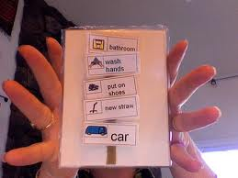
3. Support Predictability
Increasing predictability reduces problem behaviors
in patients with ASD or ID
Hospital is a new environment
All people, including our patients, need to know
  What am I doing now?
  What am I doing next?
  When will I get to eat?
  When will I get to do something I like?
They need some predictability

Slide 36

4. Positive Reinforcement Behavior Plan
High frequency, specific reward
Using rewards decreases problem behaviors
The more delayed or distressed a child is the higher
the frequency (could be every 5 minutes)
For kids with ASD – reward can be highly specific to
their interest (might be repeatedly
watching 5 minutes of Barney video)
Notes:
Triggers, Antecedents & Setting Events
- Can include physical discomfort, stressful situations, withdrawal of attention, demands to do something, changes in routine, and a variety of other issues

Slide 37
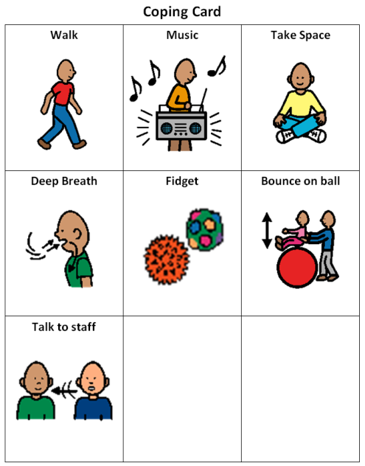
5. Concrete Coping Strategies
Agitation Management
Safety Management
Loss of control
De-escalation
Agitation
Agitation
Alert Zone
Early Warning Signs
Give Space,
then Coping Card
Baseline - Prevention
Time

Slide 38
ASD/ID Care Pathway Outcomes
Effectiveness of the ASD-CP in a public hospital child psychiatric service 18 months pre-implementation (n=17) vs 18 months post implementation (n=20).
Average length of hospital stay decreased 40%
(22.4 days to 13.4 days) p=0.07
Use of physical holds/restraints decreased 77%
(0.65/day to 0.15/day) p=0.057
- Kuriakose S, Filton B, Marr M…Siegel M, Horowitz, S, and Havens J, Does an
Autism Spectrum Disorder care pathway
improve care for children and adolescents
with ASD in inpatient psychiatric units?
J Autism Dev Disord. 2018 July 3

Slide 39
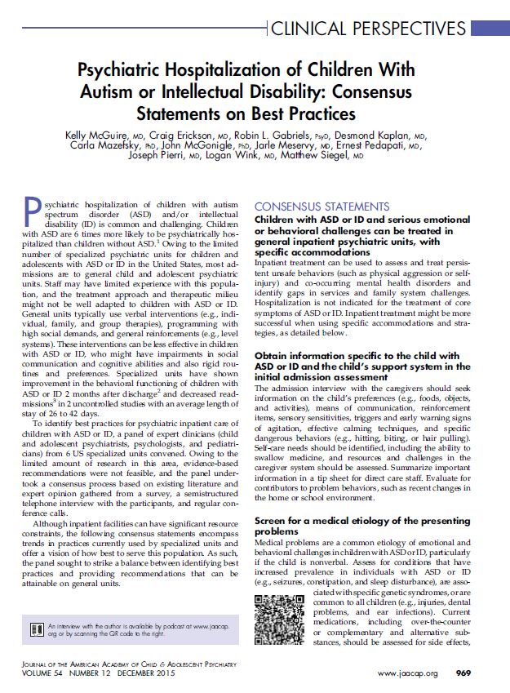

Slide 40
Consensus Best Practices For Inpatient Treatment of ASD youth
Summary of Consensus Recommendations
  Obtain information specific to child with ASD/ID
  Screen for medical etiology of challenging behaviors
  Assess for co-occurring psychiatric disorders and
  target the psychopharmacology
  Assess and support communication and
  occupational therapy needs
  Perform functional behavioral assessment and take behavioral data
- Mcguire K, Erickson E, Gabriels R…and Siegel M, Psychiatric Hospitalization of Children with Autism and Intellectual Disability: Consensus Statements on Best Practices, J Am Acad Child Adol Psychiatry, December, 2015

Slide 41
Consensus Best Practices
Recommendations Continued
Create therapeutic spaces and appropriate activities
Provide structured educational services
Provide direct care staff specific training
A longer length of stay to change behavior
Interpret standard medical necessity
criteria in context of the developmental
disorder

Slide 42

Founded 2021
Expanding from 6 to 11 members this summer
Inpatient Learning Health Network
Data collection
Quarterly benchmarking
Monthly webinars, issue briefs

Slide 43
Summary
Youth with ASD/ID can develop serious emotional and behavioral challenges. Puts them at risk for polypharmacy, community/educational exclusion, hospitalization and residential placement.
Successful treatment of refractory challenges may require a broad multi-disciplinary approach that manages acute symptoms and ameliorates key perpetuating factors, such as sleep deprivation, psychiatric co-morbidity, communication inefficiency, and environmental reinforcement.

Slide 44
Resources
Download for free at:
www.aacap.org

Slide 45
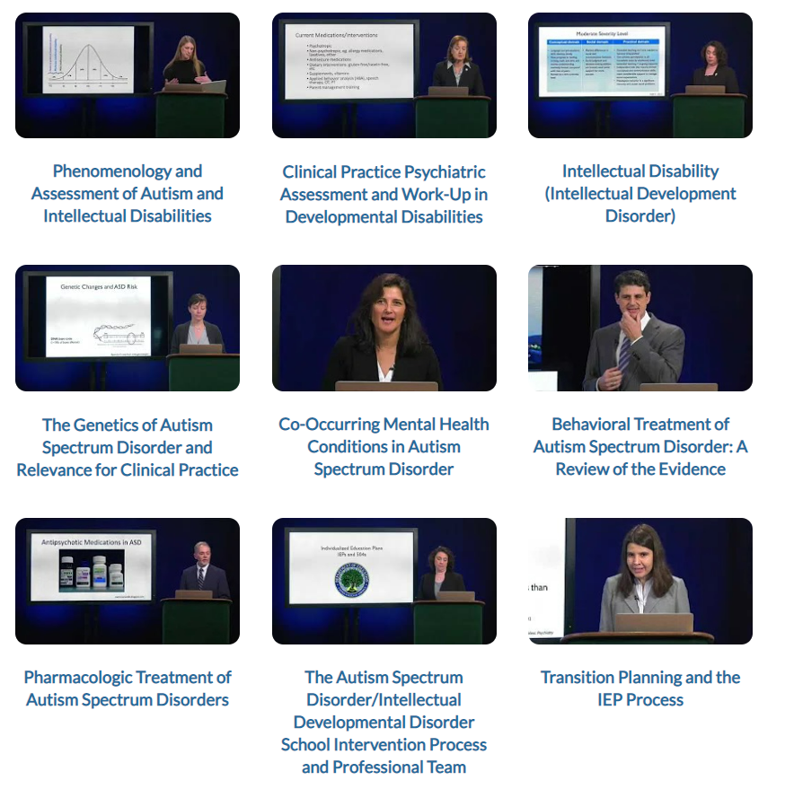
Training Resources
Practice Parameter for the Assessment and Treatment of Psychiatric Disorders in Children and Adolescents With Intellectual Disability
- Siegel M, Mcguire K,
et al, 2020, JAACAP
Practice Parameter for the Assessment and Treatment of Children and Adolescents With Autism Spectrum Disorder
- Volkmar F, Siegel M,
et al, 2014, JAACAP
www.aacap.org/AACAP/Member_Resources/ASD-ID/training_education

Slide 46



Acknowledgements
Co-Investigators
Carla Mazefsky, Ph.D, University of Pittsburgh
Robin Gabriels, PsyD., Children’s Colorado
Martine Lamy, MD, PhD, Cincinnatti Children’s
MaineHealth Institute for Research
Susan Santangelo, Sc.D., Co-Investigator
Kahsi A. Pedersen, Ph.D., Methodology/Statistics
Mary Verdi, MA, Project Manager
Melanie Hounchell, Research Program Director
Ellyn Touchette, BA, Data Coordinator
Nicki Goldfeder, BA, Research Coord.
Talia Greene, BA, Research Coord.
Mileah Sawtelle, BA, Research Coordinator
Briana Taylor, PhD, Investigator

Slide 47
Thank you
matthew.siegel@mainehealth.org

