Slide 1
The Psychiatric Intake and Response Center (PIRC) at Cincinnati Children’s Hospital
AADCAP meeting
April 28, 2023
Courtney Cinko, MD
Director of Emergency Psychiatry
Cincinnati Children’s Hospital Medical Center

Slide 2
Disclosures
none

Slide 3
Objectives:
Discuss the model of care for patients who present to our ED with psychiatric concerns
Illustrate the tasks and processes of the Psychiatric Intake Response Center (PIRC)
Highlight important aspects of the work being done by staff to provide the right care at the right time for patient seeking mental health care
Explain how initiatives outside of the ED continue to help address ED volumes for mental health patients

Slide 4
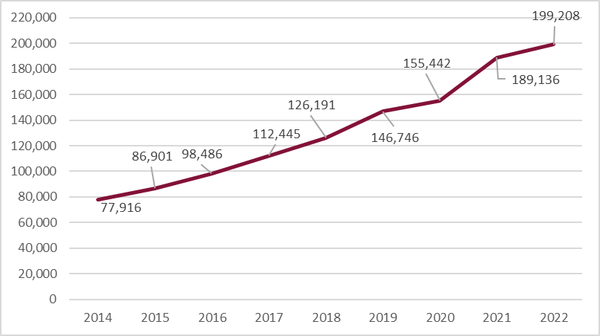
Meeting The Ever Growing Demand
Clinical Visits for Divisions of Psychiatry and Behavioral Medicine Clinical Psychology

Slide 5
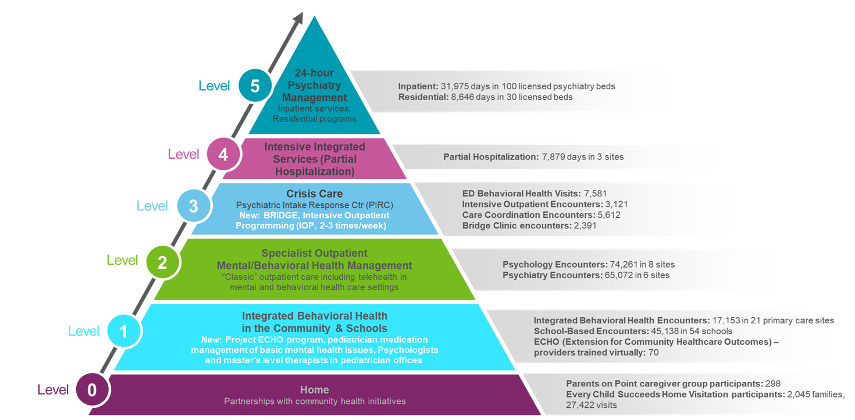
Mental Health Treatment System
Cincinnati Children’s Hospital

Slide 6
What is the Psychiatric Intake Response Center (PIRC)?
PIRC
Crisis Assessment Team
(ED and Crisis Calls)
Overflow/ED Boarded Team
Bridge Clinic
Operations
Community Outreach

Slide 7
Crisis Assessment Team
Licensed independent Social Workers (LISWs) and Licensed Practicing Clinical Counselors (LPCCs)
24/7 staffing for ED assessments
Serves as a consult service to the ED to recommend disposition for patients who presents with MH complaints
Full psychiatric assessment with focus on risk, safety planning, and referrals for services in the community
Part of Psychiatry, not ED
On-call psychiatrist is consulted for every patient that PIRC recommends for discharge

Slide 8
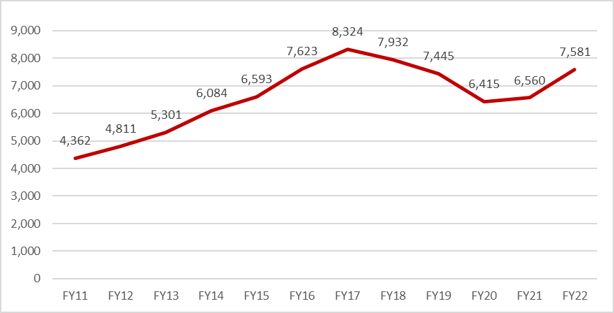
Annual ED Visits for Psychiatric Evaluations

Slide 9

Assessment Process for ED Patients
Inpatient:
-Bed requested
-ED staff work with Flow coordinators for bed assignment, transportation
-If patient waits over 12 hours for a bed, then seen by overflow team
Patient presents to the ED with MH complaint
Patient Triaged through ED, labeled as “psych eval” on track board, roomed
Patient seen by MD/APRN for medical clearance
Patient seen and assessed by PIRC clinician
Disposition recommendation (inpatient, PHP, IOP, outpatient) made to ED staff
Outpatient:
-Referrals if needed
-PIRC creates home safety plan
-PIRC clinician discusses case with
on-call psychiatrist

Slide 10
Elements of Full PIRC Assessment
Narrative of presenting concerns
Identifying guardianship and custody
Identifying outpatient services in place (will attempt to contact treatment team)
Social History
Areas of concerns/strengths
Child Abuse and Exploitation Screens
Columbia Suicide Severity Rating Scale, full
BRACHA- scale for level of aggression
Mental Status Exam
CBT interventions
Safety planning
PIRC recommendations

Slide 11
Disposition to Appropriate Level of Care
Main work of PIRC is to determine the level of care MOST appropriate for each patient based on assessment and clinical judgment
CAP MD available via phone 24/7 to discuss cases with clinicians; discharges require approval from CAP MD
Barriers to discharge to PHP, IOP, and outpatient services can lead to inpatient admission by default as that is the safest, fastest option for care
Actively working to address these barriers through multiple QI efforts within our own system and with our community partners

Slide 12
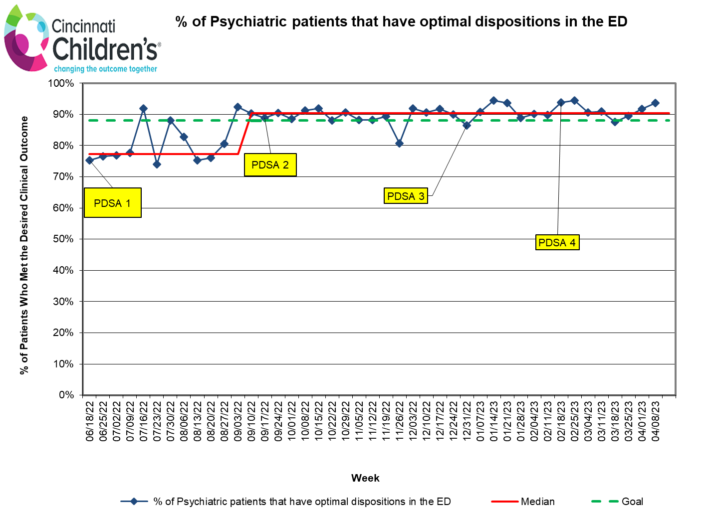
Numerator: Total # of patients seen in ED who have a discharge no barriers + admission that are clinically appropriate + total # of patients that discharge despite barriers​
​
Denominator: Total number of patients seen in the ED for psychiatric evaluation
Notes:
Continued work and understanding variation in clinical judgement regarding clinically appropriate admissions and discharge.

Slide 13
ED Boarded/Med Overflow Processes
Patient needing admission to inpatient psychiatry; bed requested
Patient waiting in ED for 12 hours OR waiting on medical floor for over 24 hours
Overflow team reassesses patient, works to overcome barriers to discharge if present (placement, no outpatient services, family factors, etc.)
Reassessments and discharge planning occur until patient is able to discharge safely OR acquire an inpatient bed

Slide 14
ED Boarded/Med Overflow Reassessments
JCAHO guidelines suggest reassessment at least every 24 hours, PIRC reassess ED boarded patients every 12 hrs. and patients on medical floor overflow every 24 hrs.
  Every 8 hours was too cumbersome and not much changed between reassessments
  Patients on medical overflow are followed by Pediatric Hospital Medicine team, thus the need for fewer reassessments
LSWs and LPCs supervised by independently licensed clinicians
Elements of Reassessment:
  Observations/clinical information
  Additional family/provider collateral clinical information
  MSE
  Risk Assessment: CSSR-S short, BRACHA
  Updated Plan of Care (recommended disposition)

Slide 15
ED Overflow Team and Barriers to Discharge
Many patients have barriers to discharging them to optimal outpatient levels of care which include lack of outpatient services, unable to contact guardian/parent, inability for family to create a safety plan for home, parent refusal to pick up child, etc.
The overflow team addresses these barriers when present; they communicate and coordinate with outpatient care teams, child protective services, parents, and referral sources
10-15% of ED boarded/overflow patients are discharged PRIOR to receiving an inpatient psychiatry bed

Slide 16

ED Crisis Assessment Model Advantages
Allows for psychiatry to keep pace with high volumes of patients
Allows for team approach to discharge planning by most knowledgeable individuals
LISW/LPCC direct interventions for abuse, trauma, family crisis

Slide 17

ED Crisis Assessment Model Limitations
No direct treatment of psychiatric patients that present to the ED
  No psychiatrist to talk with families regarding diagnosis, treatment, and prognosis
  No mechanisms for medication changes or refills (for patients not in our system)
Embedded within medical ED, not separate mental health emergency services
  Most staff with minimal mental health/crisis training
  ED values decreased time in department, whereas getting psych patients to the right level of care takes time (priorities can be at odds)
Inpatient admission can be easier to achieve than planning for discharge

Slide 18
ED Assessments by the Numbers (FY23 So Far)

Slide 19
PIRC Bridge, Operations, Crisis Assessment Calls and Community Outreach
Escaping the ED as the Access Point for Mental Health Care

Slide 20
Bridge Clinic
Rapid access crisis assessment and intervention clinic (LISWs and LPCCs)
  Patients can usually get an appointment within 1-2 days, typically see patients through crisis (3-4 sessions)
  “Bridges” care for patients who do not have services in place
  Helps families navigate the mental health system and coordinates referrals
  Helps decompress ED by being a referral resource for patients in the community AND patients stepping down from the ED
Medication Treatment (MD and APRN)
  Patients can usually get an appointment within 2-3 weeks
  Also meant to “bridge” care for patients without services
  Most patients seen in bridge are seen for crisis assessment/intervention; PIRC clinicians refer those patients with severe symptoms or with concerns related to medications

Slide 21

Bridge Clinic
Full PIRC assessment
Crisis Evaluation
Interventions relative to presenting problem
  CBT model
  Coping skills
  Behavior activation
  Behavior management skills
  Review and Revision of safety plans
Referrals to community therapists
(and medication treatment if needed)

Slide 22
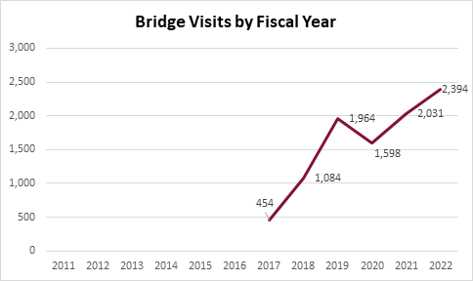

Slide 23
Operations Team
Staffed by Intake Coordinators: usually Bachelor’s level, non-clinical
Processes referrals into the psychiatry system
Calls families to discuss referrals and treatment options in the community
Answers phone calls and routes them to appropriate point of contact to address needs (crisis assessment team, nursing line, etc.)

Slide 24
Crisis Assessment Phone Calls
Calls come in via crisis line and fielded by intake coordinator
Calls then transferred to available PIRC clinician for assessment of crisis to determine appropriate crisis intervention services (ED, Bridge, mobile crisis etc)
Referred to outpatient services or the ED

Slide 25

Crisis Assessment Phone Calls
Crisis Calls
(Jan-Mar 2023)
  Total crisis calls: 756
  Referred to the community or Bridge: 482
  Referred to the ED and presented to the ED: 197
  Other: 77

Slide 26

Community Outreach
Trainings
Trauma Informed Care in schools
Building Resilience in Schools
CSSRS
Supervision
Presentations
PIRC & CCHMC psychiatry overview
When to refer to the ED for psychiatric assessment
Accessing the PIRC Crisis Assessment Team

Slide 27
Psychiatrist Role in PIRC
Leadership: liaison to Emergency Medicine Department
PIRC leadership team
Provides guidance and joint ownership of clinical processes
Available M-F 8 AM-4:30 PM
  Review cases with PIRC clinicians
  Assess difficult cases in ED
  Assist overflow/ED boarded team
  Available to ED physicians for consultation
Clinical time in Bridge Clinic
In addition to on-call CAP MD

Slide 28
How Is It All Paid For?
PIRC:
ED billing + subsidization by the hospital to ensure 24/7 staffing
$5.8M in expense – billing brings in about $2.1M
Bridge:
Outpatient billing
Mix of gift, endowment and Convalescent Board funding.

Slide 29
Summary
The Cincinnati Children’s Psychiatric Intake Response Center has many responsibilities within our large system of care.
Licensed, independent clinicians (LISWs and LPCCs) assess patients in the ED, in bridge clinic, and through crisis calls
Supervised LSWs and LPCs run a successful overflow/ED boarded reassessment team
PIRC is the primary driver in an effort to prevent MH patients from presenting to the ED unless clinically necessary

Slide 30
Questions?

